Slide 1
Acceptance vs experience of domestic violence

Slide 2
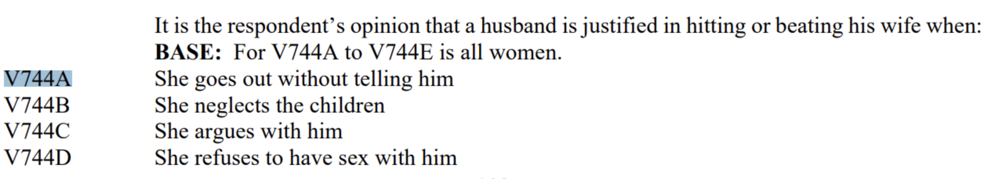
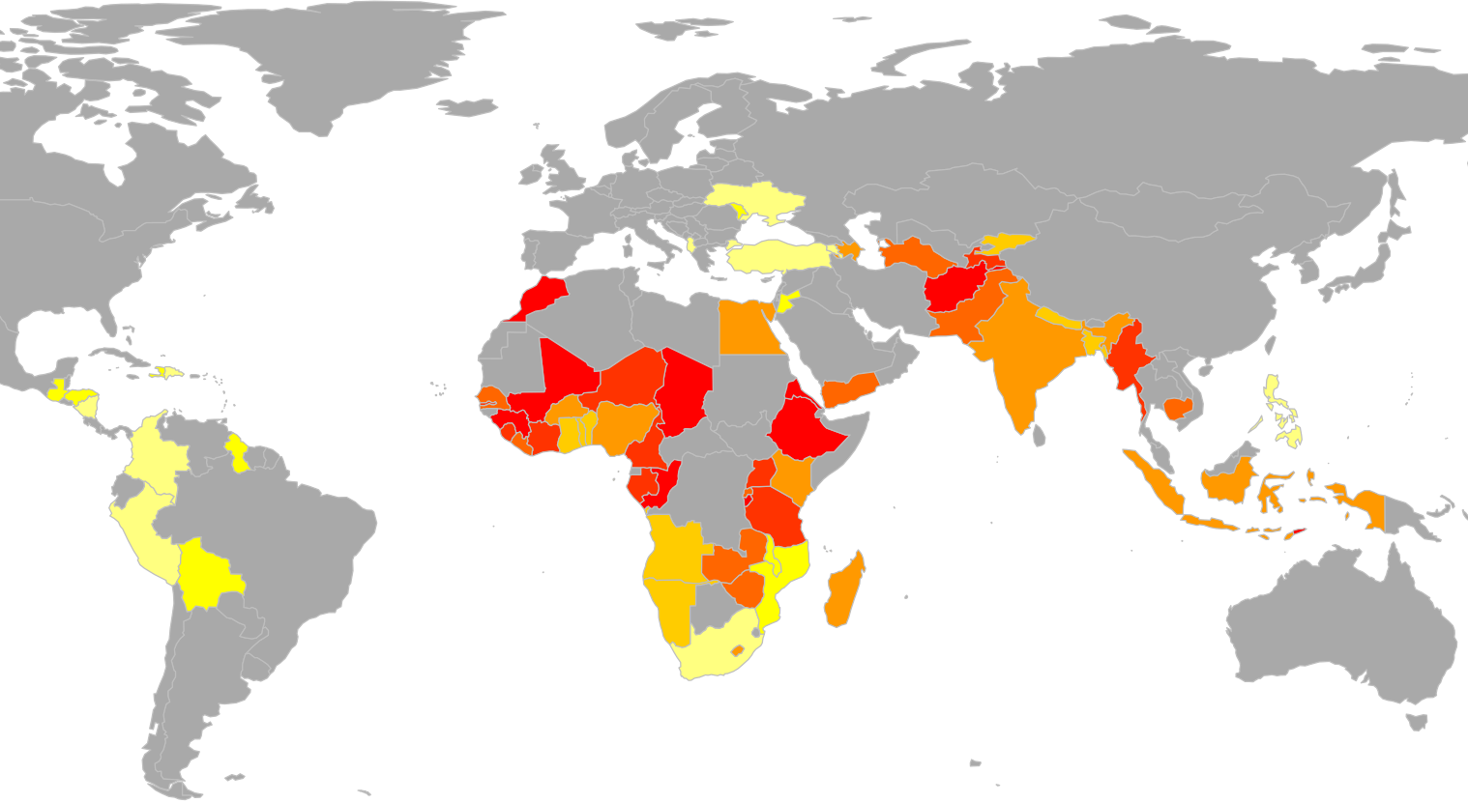
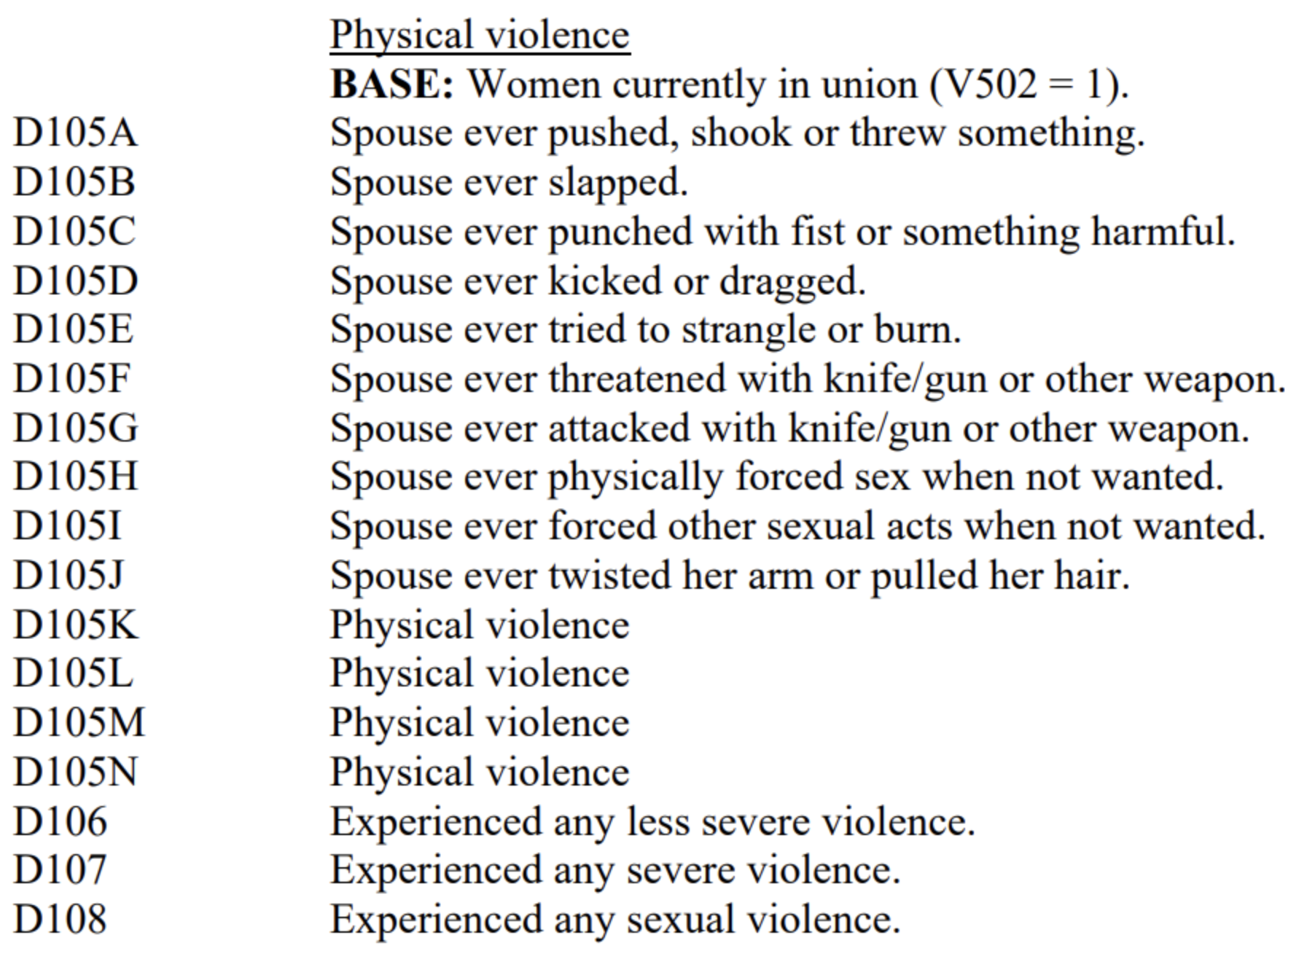

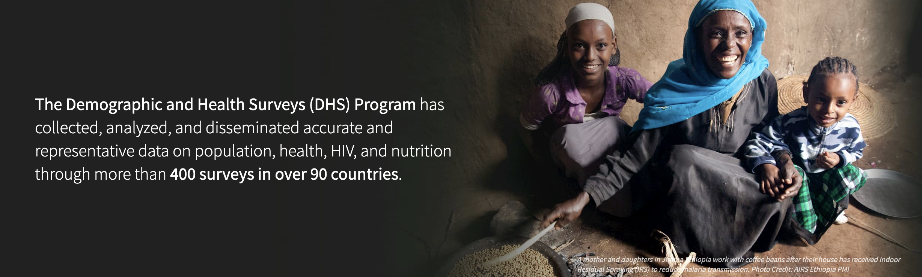
Distribution of acceptance vs experience of violence
Acceptance: % of yes to at least one answer of:
Our goals are:
to investigate the perception vs experience of violence
to determine controlling factors of domestic violence
to propose a tool to quickly identify women in need of help before they experience violence
Experience: % of yes to at least one answer of:

Slide 3
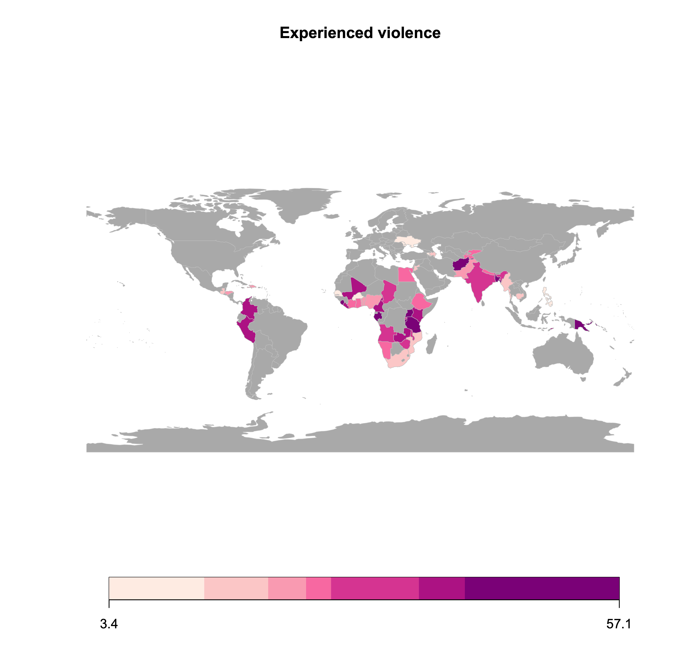
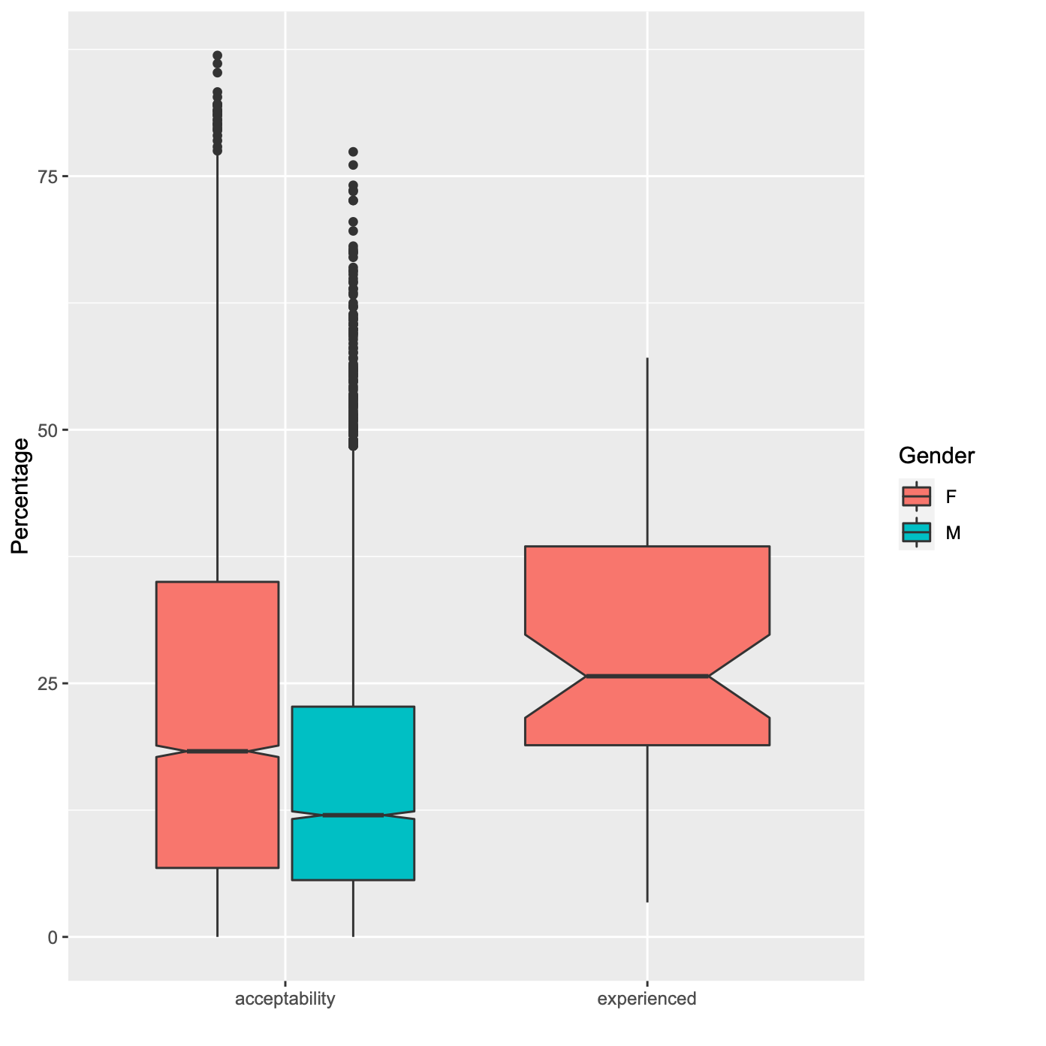
Distribution of acceptance and experience of domestic violence
If we have a map with barplots this graph might become redundant. Maybe a scatter plot would reveal a correlation or clusters?
ideally only map with bar plots for acceptance vs experience
Take-away message for this slide. e.g.
women tend to find violence more acceptable than men do.
domestic violence is widespread amongst the country investigate, where on average 26% of women have experienced physical or sexual domestic violence

Slide 4
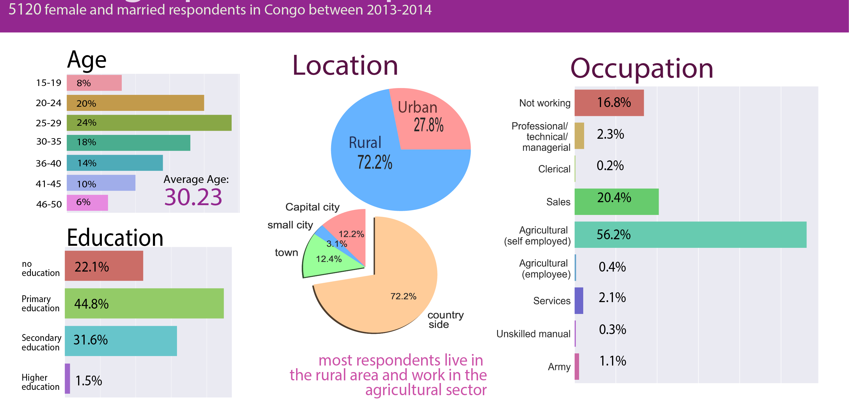
Does demographics influence the occurence of domestic violence?
This slide is for the moment about the general demographics of the respondent. It would be an important method slide for a 10+ minutes talk. But since we have so little time we have to be straight to the point. So this slide should give an important information about acceptance or experience of violence
the takeaway message should say something about experience or experience of violence

Slide 5
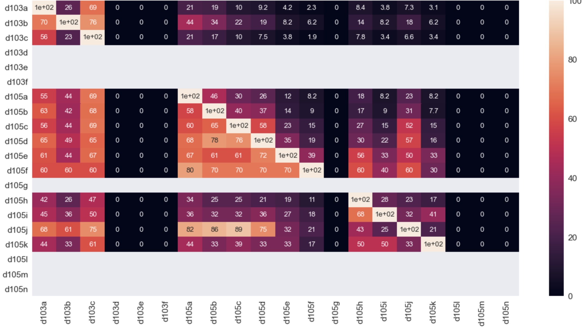
Main risk factors and pre-violence factors
Ideally, here we demonstrate that emotional violence predates physical or sexual violence

Slide 6
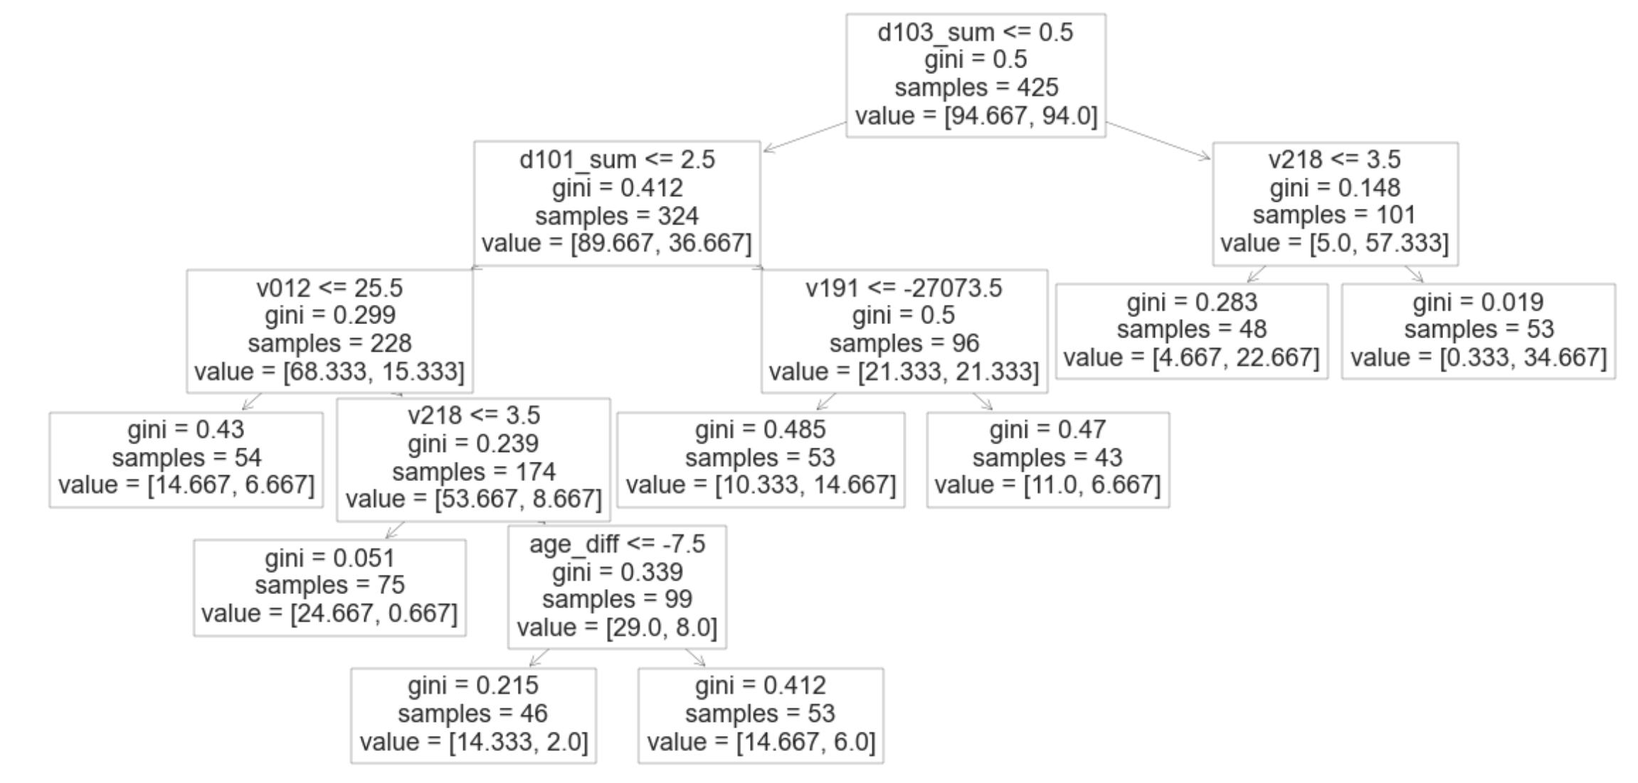
Diagnostic AI-tool
Of course the final graph will be cleaner
We aim to predict whether a woman is susceptible to experience domestic violence
We want a diagnostic test that can be performed in less than two minutes either automatically, on paper, or given by a non-expert.
We chose a decision-tree for its “white-box” approach. The decision-tree proposes a short series of questions. Each new question is personalized in function of the previous answer, so that the size of the questionnaire can be really small.
We obtain reasonnably good results by asking less than five questions

Slide 7
Conclusion

Slide 9
How much do men and women find violence acceptable?
Is there a correlation between acceptance and experience of violence?
How do demographics influence
What are signs that a relationship is or could evolve into domestic violence?
We propose an AI-powered tool to quickly identify women in need of help
Notes:
We base our project on the data from the Demographic and Health Surveys (DHS) program

